Slide 2
Tools for scaling R using Azure
John-Mark Agosta, Principal Data Scientist Manager
Vanja Paunić, Data Scientist
Barbara Stortz, Principal SWE Manager
Acknowledgements: Ali-Kazim Zaidi, Microsoft
Mario Inchiosa, Microsoft
Debraj GuhaThakurta, Microsoft

Slide 3
Session Goals
How to scale R code with distributed, parallel, and off-memory processing
How to develop scalable E2E R data-science process
How to easily operationalize code and models written in R
How to use cloud infrastructure (single node or clusters) to develop, scale, operationalize
Notes:
This slide is required. Do NOT delete. This should be the first slide after your Title Slide.
This slide should describe what your goals are for this session. This information lets your audience know what you are trying to accomplish with your talk or tutorial—ie, what value will attendees get by investing 25 minutes or 2 hours of their time listening to you.
You should not spend more than 1 minute presenting this slide.
General examples of session goals could be (you will have to create your own specific goals):
Introduce a new technique or approach to solve a customer problem
Compare two approaches and explain why one is superior
Describe a project and the learnings that audience members can apply from it
Teach audience members how to use a specific technology

Slide 4
Tutorial Outline
Introduction [40 mins]
R language
IDEs for R
Libraries most used
R in the Cloud [50 mins]
Spark
Azure Batch
RevoScaleR, MicrosoftML, h2o
R operationalization [50 mins]
Azure ML
R Server with SQL Server
mrsdeploy
4

Slide 5
Introduction
R language
IDEs for R
Libraries most used

Slide 6

Language
Platform
The most popular statistical programming language
Originally designed by two University of Auckland Professors for their introductory statistics course
A data visualization tool
Open source
What is
Community
2.5+M users
Taught in most universities
Many common use cases across industry
Thriving user groups worldwide
5th in 2016 IEEE Spectrum rank
42% pro analysts prefer R (highest amongst R, SAS, python)
Ecosystem
10,000+ contributed packages
Rich application & platform integration
6

Slide 7
R Philosophy
R follows the Unix philosophy
Write programs that do one thing and do it well (modularity)
Write programs that work together (cohesiveness)
R is extensible with more than 10,000 packages available at CRAN (http://crantastic.org/packages)
7

Slide 8
Lazy evaluation in R
R, like its inspiration, Scheme, is a functional programming language
R evaluates lazily, delaying evaluation until necessary, which can make it very flexible
R is a highly interpreted dynamically typed language, allowing you to mutate variables and analyze datasets quickly, but is significantly slower than low-level, statically typed languages like C or Java
R has a high memory footprint, and can easily lead to crashes if you aren't careful
8

Slide 9
R Strengths and Weaknesses
Where R Succeeds
Expressive
Open source
Extendable -- nearly 10,000 packages with functions to use, and that list continues to grow
Focused on statistics and machine learning -- cutting-edge algorithms and powerful data manipulation packages
Advanced data structures and graphical capabilities
Large user community, both within academia and industry
It is designed by statisticians
Where R Falls Short
It is designed by statisticians
Inefficient at element-by-element computations
May make large demands on system resources, namely memory
Data capacity limited by memory
Single-threaded
9

Slide 10
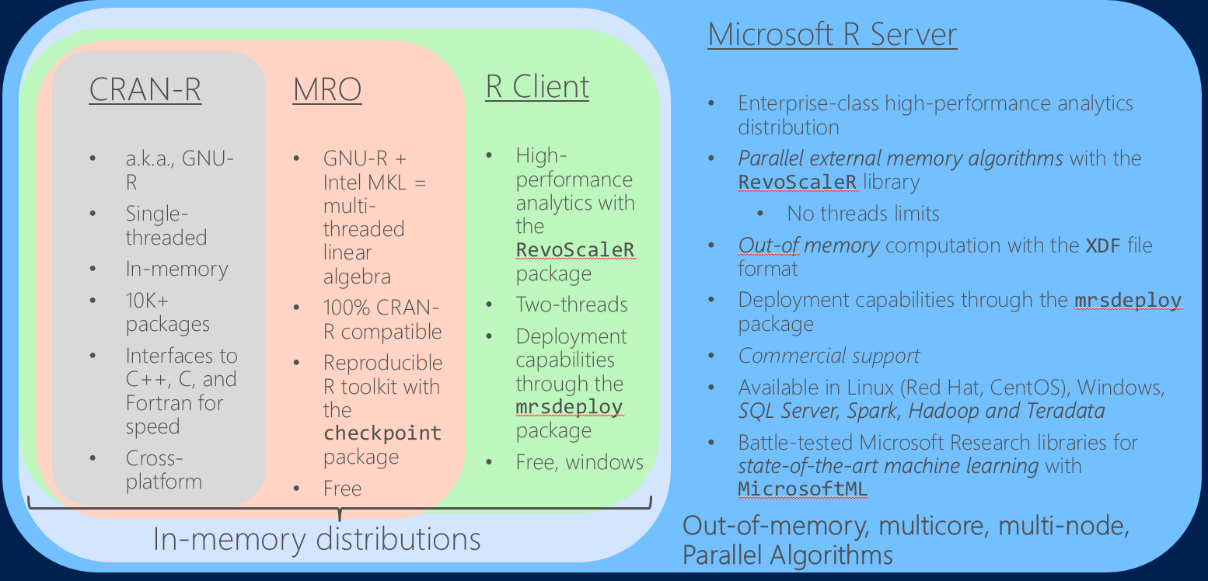
Distributions of R
10

Slide 11
R IDEs
The most popular integrated development environment for R is Rstudio
The RStudio IDE is entirely html/javascript based, so completely cross-platform
RStudio Server provides a full IDE in your browser: great for cloud instances
R Tools for Visual Studio, RTVS became generally available in 2016 for Windows machines
RTVS supports connectivity to Azure and SQL Server for remote connectivity
And more: Jupyter notebooks, Emacs + ESS, etc.
11

Slide 12
Essential open source packages
There are over 10,000 R packages to choose from, what do I start with?
Data Management: dplyr, tidyr, data.table
Visualization: ggplot2, ggvis, htmlwidgets, shiny
Data Importing: haven, RODBC, readr, foreign
Other favorites: magrittr, rmarkdown, caret
12

Slide 13






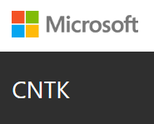


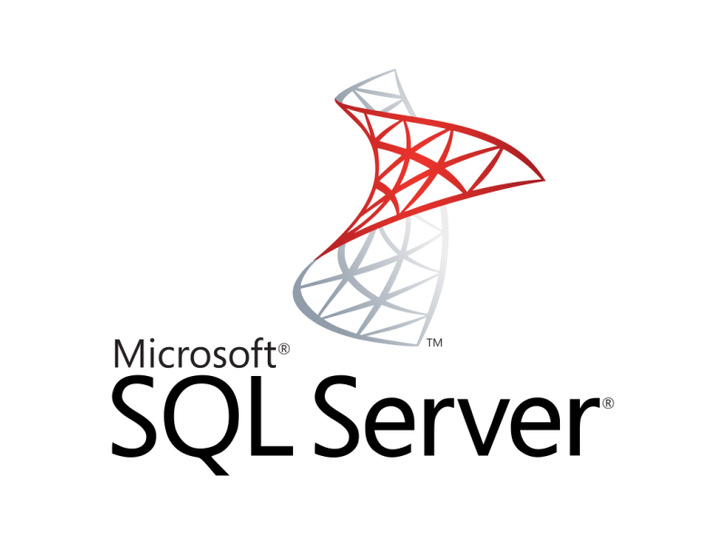



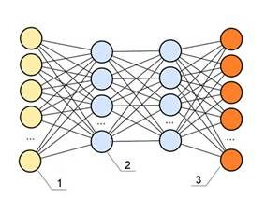

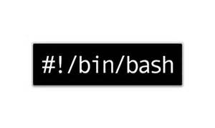



Single node Azure Linux DSVM w/ Spark (for Hands-On)
Data-science virtual machine (DSVM)
Vowpal Wabbit
Spark 2.0.2
HDFS (local)
Yarn
More info at:
http://aka.ms/dsvm
xgboost
Rattle
Developer edition
CNTK
13

Slide 14
GitHub repository for all code and scripts
The github page currently private, will be open to public at the time for event
http://tinyurl.com/AI-Immersion-ScalingROnAzure
14

Slide 15
Hands on
Setup
Intro to R
15

Slide 16
R in the Cloud
Spark
Azure Batch
16

Slide 17
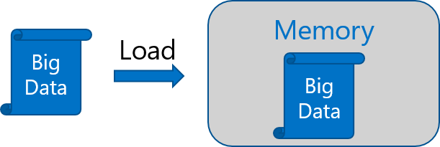
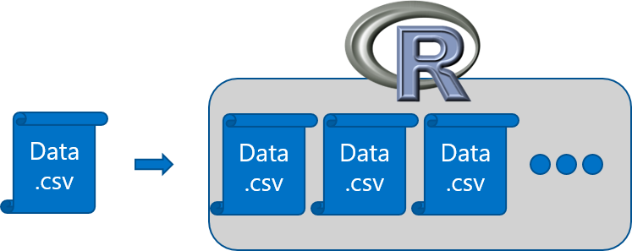
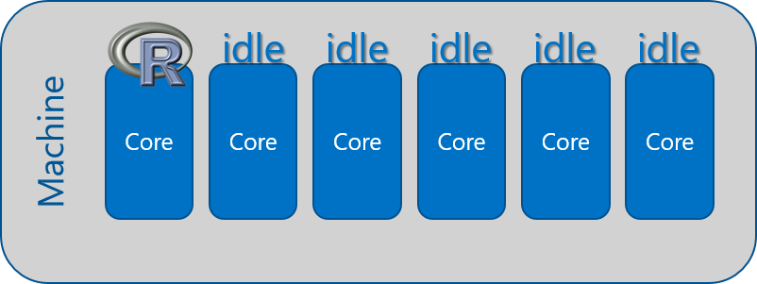
R adoption is on a Tear But there are several issues regarding scalability
In-Memory Operation
Expensive Data Movement
& Duplication
Lack of Parallelism
17

Slide 18
Scalable R solutions
R packages for distributed computing
SparkR
sparklyr
RevoScaleR (Microsoft R Server)
MicrosoftML (Microsoft R Server)
doAzureParallel
h2o
and more!
18

Slide 19
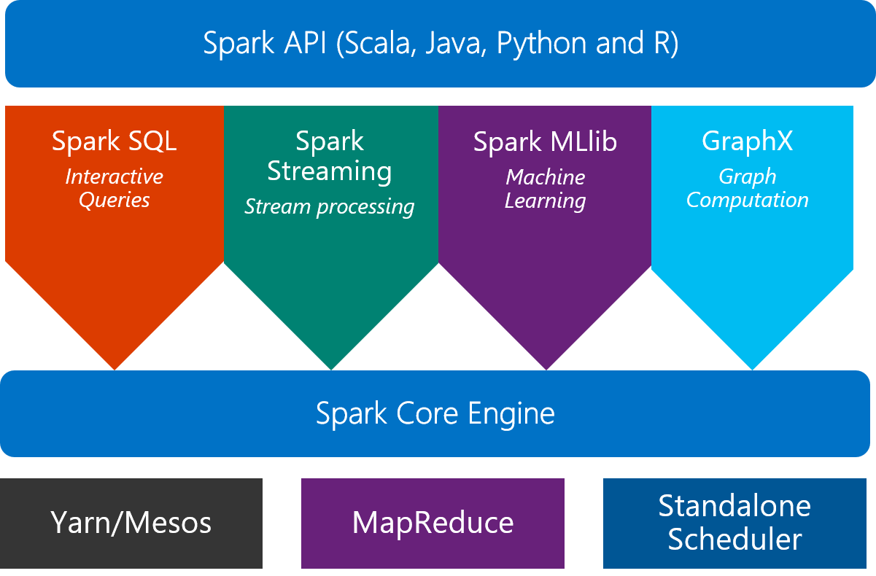
Spark
What is Spark?
An unified, open source, parallel, data processing framework for Big Data Analytics
19

Slide 20
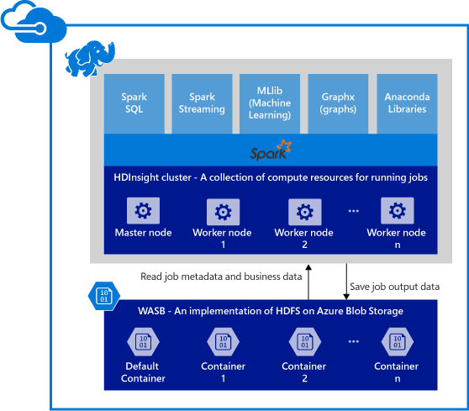
Spark clusters in Azure HDInsight
Provisions Azure compute resources with Spark 2.0.2 installed and configured.
Supports multiple versions (e.g. Spark 1.6).
Stores data in Azure Blob storage (WASB), Azure Data Lake Store or Local HDFS.
20

Slide 21

SparkR: a Spark API
An R package provides a light-weight frontend to use Apache Spark from R and allows data scientists to analyze large datasets.
SparkDataFrame is distributed collection of data organized into named columns.
SparkR can create SparkDataFrames from local R data frames, csv, json and parquet files.
With Hive support, it can also access tables from Hive MetaStore.
Pre-configured on Spark clusters in Azure HDInsight.
21

Slide 22
SparkR: Data processing and modeling
Supports functions for structured data processing:
Selections: select, filter
Grouping, Aggregations: summarize, arrange
Running local R functions distributed: spark.lapply
Applying UDFs on each partition/group of a SparkDataFrame: dapply, dapplyCollect, gapply, gapplyCollect
Uses MLlib to train models and allows model persistence.
Generalized Linear Model
Survival regression
Naive Bayes
KMeans
Logistic Regression
Gradient Boosted Tree
Random Forest
… others
22

Slide 23

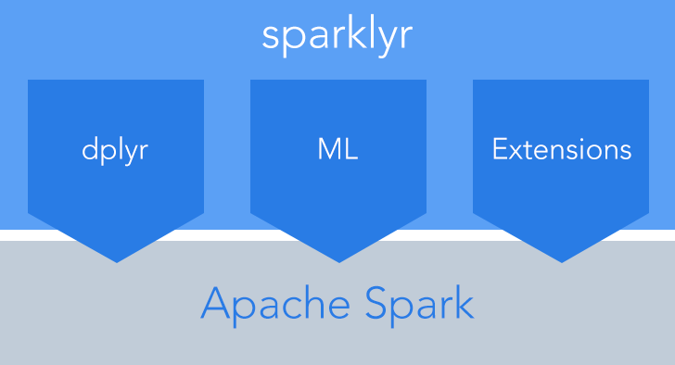
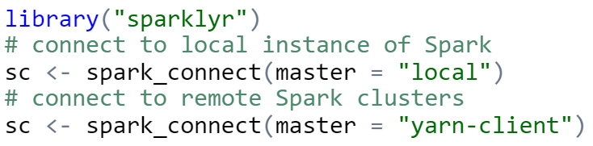
sparklyr: R interface for Apache Spark
Easy installation from CRAN
Connect to both local instances of Spark and remote Spark clusters
Loads data into SparkDataFrame from: local R data frames, Hive tables, CSV, JSON, and Parquet files.
Source: http://spark.rstudio.com/
23

Slide 24
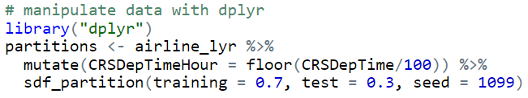
sparklyr: dplyr and ML
Provides a complete dplyr backend for data manipulation, analysis and visualization
%>%
Includes 3 family of functions for machine learning pipeline
ml_*: Machine learning algorithms for analyzing data provided by the spark.ml package.
K-Means, GLM, LR, Survival Regression, DT, RF, GBT, PCA, Naive-Bayes, Multilayer Perceptron, LDA
ft_*: Feature transformers for manipulating individual features.
sdf_*: Functions for manipulating SparkDataFrames.
24

Slide 25
R Server: scale-out R, enterprise class
100% compatible with open source R
Any code/package that works today with R will work in R Server.
Ability to parallelize any R function
Ideal for parameter sweeps, simulation, scoring.
Wide range of scalable and distributed rx pre-fixed functions in RevoScaleR package.
Transformations: rxDataStep
Statistics: rxSummary, rxQuantile, rxChiSquaredTest, rxCrossTabs…
Algorithms: rxLinMod, rxLogit, rxKmeans, rxBTrees, rxDForest…
Parallelism: rxSetComputeContext
Runs on Spark, Hadoop, SQL Server, Teradata
25

Slide 26

R Server + Azure HDInsight: Managed Hadoop for Advanced Analytics in the Cloud
R
Easy setup, elastic, SLA
Ubuntu Linux
Cloud Storage
Spark
R Server
Leverage R skills with massively scalable algorithms and statistical functions
Reuse existing R functions over multiple machines
SparkR functions
RevoScaleR functions
Spark and Hadoop
Blob Storage
Data Lake Storage

Slide 27
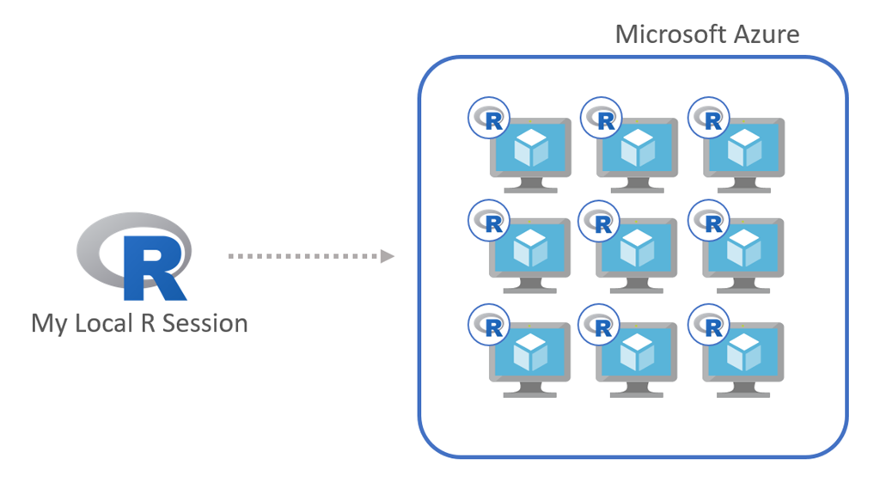
Azure Batch
doAzureParallel - a lightweight R package built on top of Azure Batch
doAzureParallel lets you execute multiple processes across a cluster of Azure virtual machines, from your local R session
In just a few lines of code, the package helps you create and manage a pool of Azure VMs, and register it as a parallel backend.
27

Slide 28
Hands on: SparkR and R Server
Airline delay prediction demo
28

Slide 29
Typical advanced analytics lifecycle
Prepare: Assemble, cleanse, profile and transform diverse data relevant to the subject.
Model: Use statistical and machine learning algorithms to build classifiers and regression models
Operationalize: Make predictions and visualizations to support business applications
Prepare
Model
Operationalize

Slide 30
Airline Arrival Delay Prediction Demo
Clean/Join – Using SparkR from R Server
Train/Score/Evaluate – Scalable R Server functions
Deploy/Consume – Using mrsdeploy from R Server

Slide 31
Airline data set
Passenger flight on-time performance data from the US Department of Transportation’s TranStats data collection
>20 years of data
300+ Airports
Every carrier, every commercial flight
http://www.transtats.bts.gov

Slide 32
Weather data set
Hourly land-based weather observations from NOAA
> 2,000 weather stations
http://www.ncdc.noaa.gov/orders/qclcd/

Slide 33
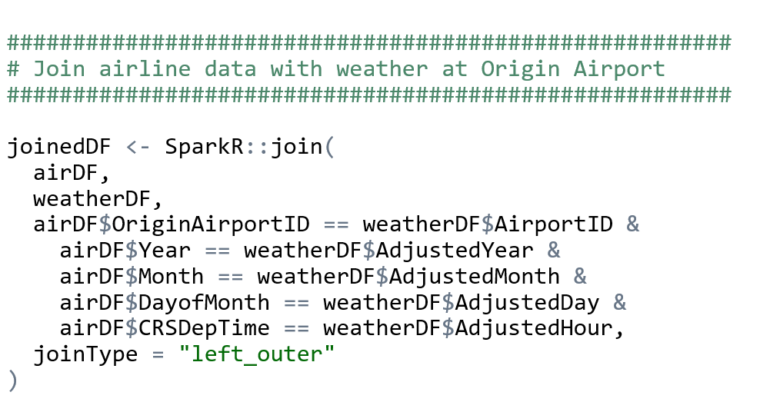
Clean and Join using SparkR in R Server

Slide 34
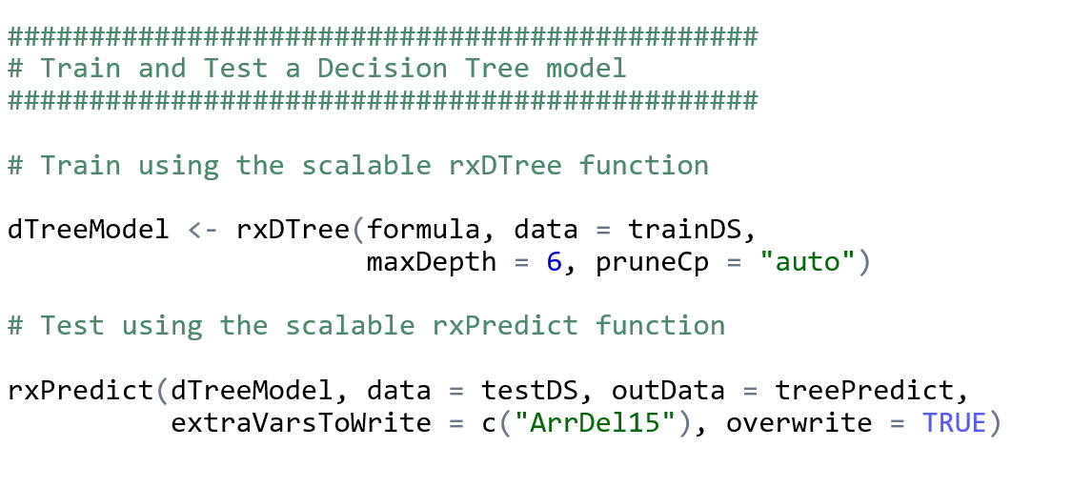
Train, Score, and Evaluate using R Server

Slide 35
R operationalization
mrsdeploy
Azure ML
R Server with SQL Server
35

Slide 36


Microsoft R Server: mrsdeploy
Easy Consumption
Explore and consume services in R directly
Data Scientist
Easy Deployment
Turn R into web services in one line of code
Microsoft R Client
(mrsdeploy package)
Data Scientist
Services / Sessions
getService
Microsoft R Client
(mrsdeploy package)
publishService
Microsoft R Server
configured for
operationalizing R analytics
REST API calls
Easy Setup
In-cloud or on-prem
Adding nodes to scale
High availability & load balancing
Remote execution server
Apps
Easy Integration
Swagger-based APIs: easy to consume with any programming language
Developer
36

Slide 37

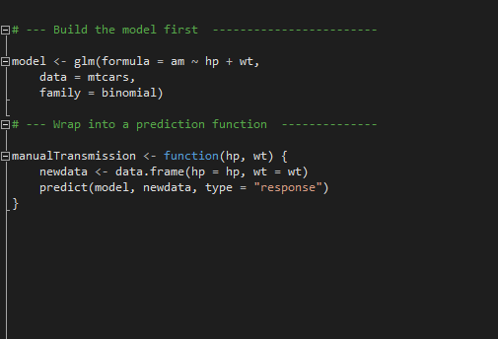
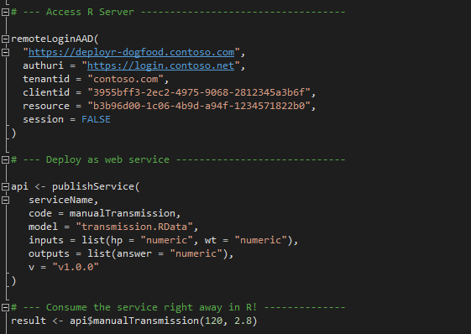
Microsoft R Server: mrsdeploy
Build the model first
Deploy as a web service instantly
https://msdn.microsoft.com/en-us/microsoft-r/operationalize/configuration-initial
https://msdn.microsoft.com/en-us/microsoft-r/operationalize/admin-utility
37

Slide 38
AzureML
AzureML: An R interface to AzureML experiments, datasets, and web services from your local R environment.
The main functions in the package cover:
Workspace: connect to and manage AzureML workspaces
Datasets: upload and download datasets to and from AzureML workspaces
Publish: define a custom function or train a model and publish it as an Azure Web Service
Consume: use available web services from R in a variety of convenient formats
38

Slide 39
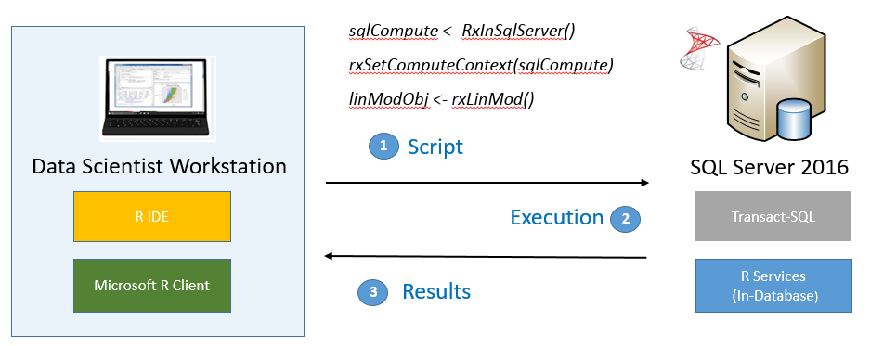
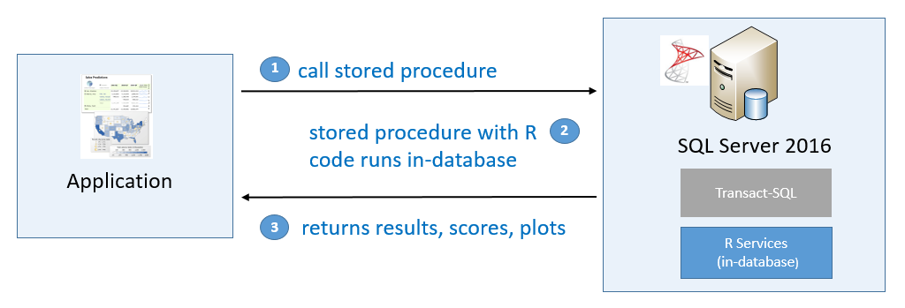
SQL Server R Services
SQL Server R Services is a feature that became available in SQL Server 2016 which allows you to build predictive applications at scale using the open-source R language (Python became available in SQL Server 2017).
Develop Your R (or Python) Solutions
Deploy and Consume
39

Slide 40
Hands on
mrdeploy: Airline delay prediction demo
AzureML
40

Slide 41
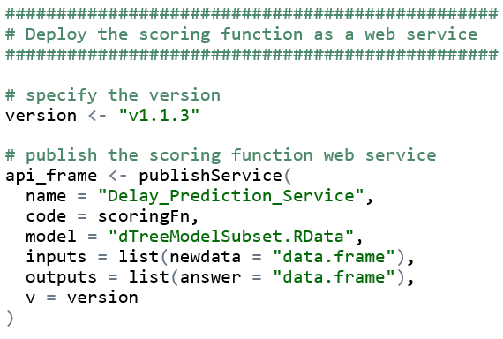
Publish Web Service from R

Slide 42
Q & A
42

Slide 43
Extras
43

